Slide 1



Slide 2
Netflix Dataset

Slide 3


Netflix Dataset
Presenters Names
Shubham Sharma
Ronil Surve

Slide 4

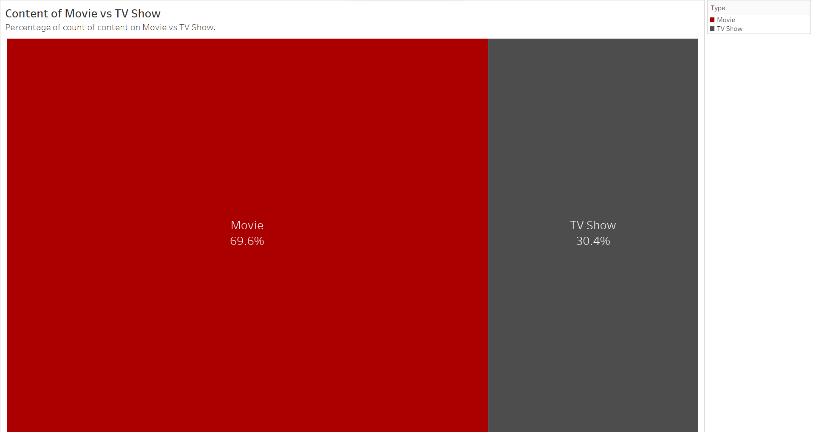
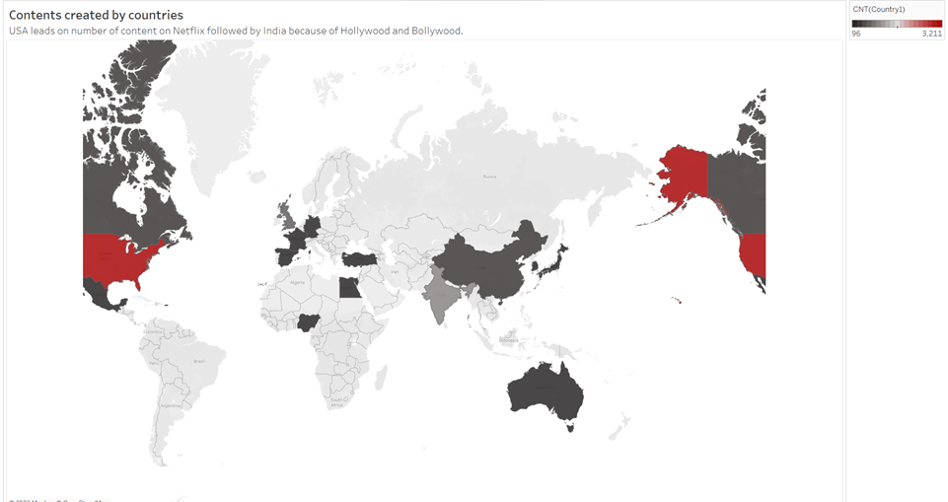
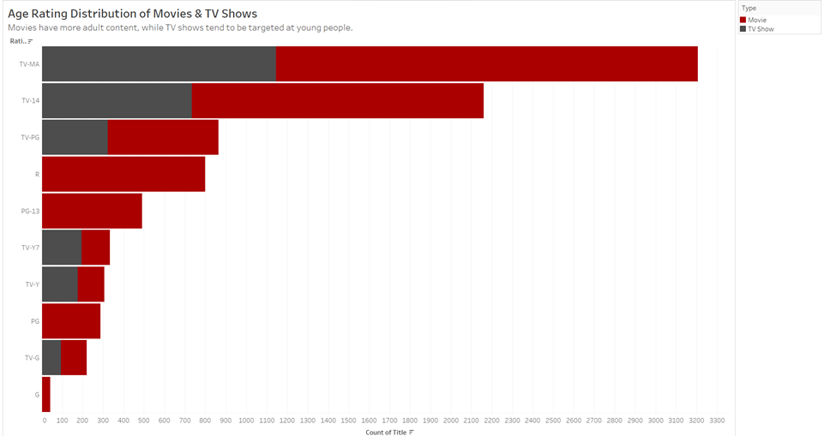
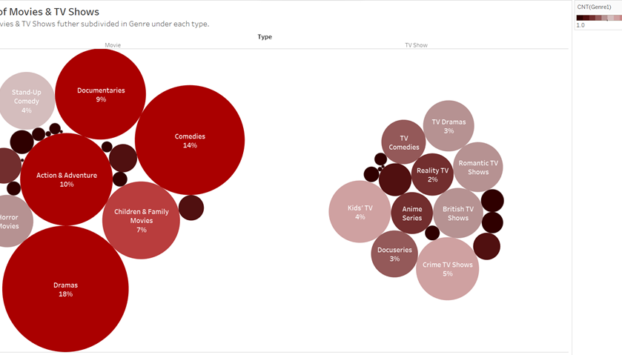
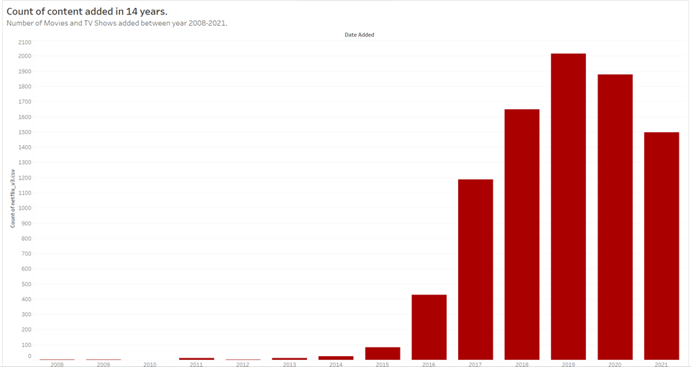
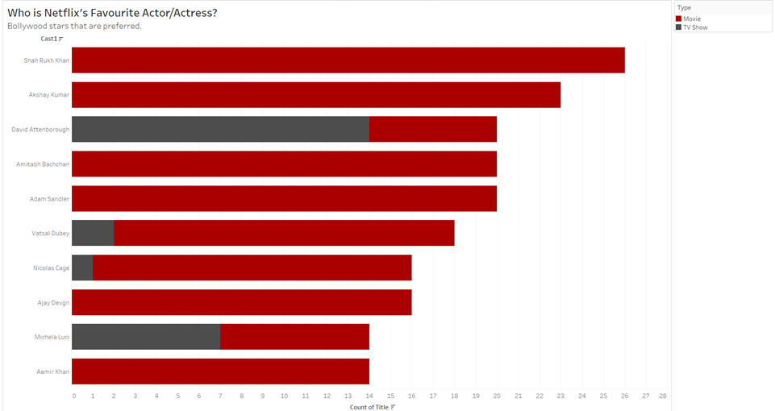
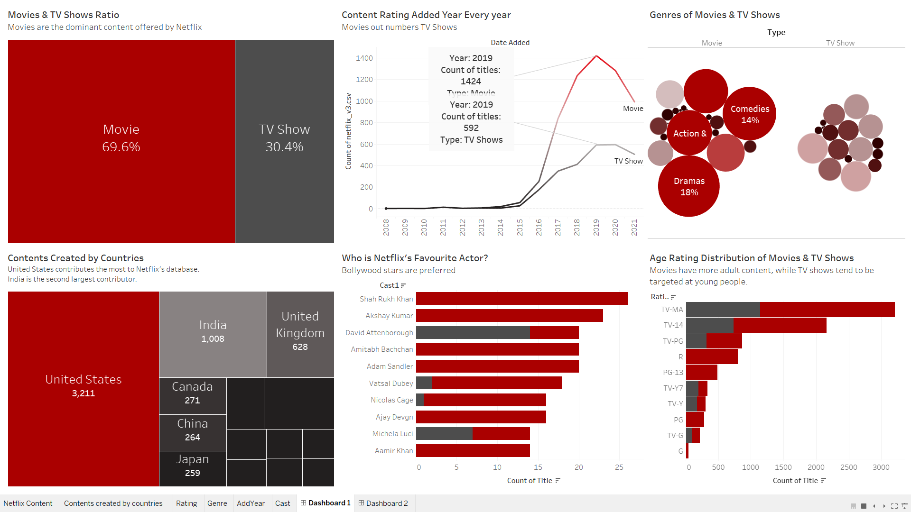
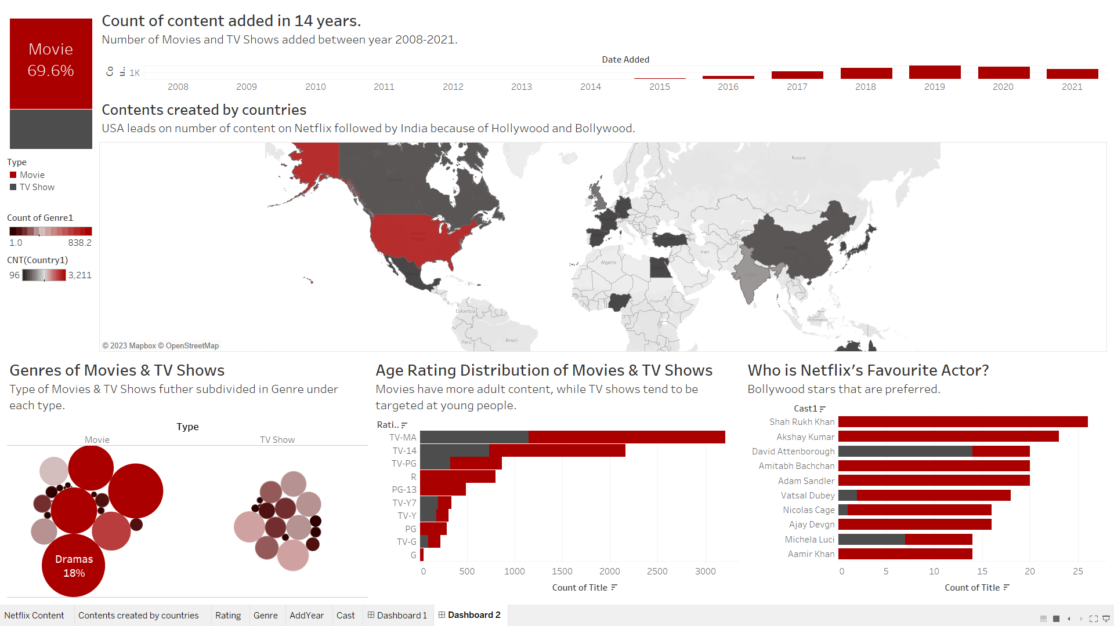
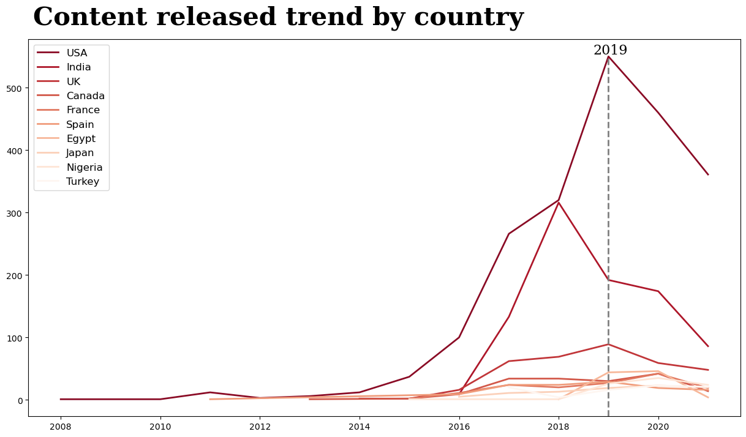
Netflix Dataset
4
Objectives
97% for you
16+
2023
Develop a Tableau-Python dashboard for Netflix content analysis.
Identify similar content through text features.
Analyze Netflix staff network.
Analyze Netflix's focus on TV shows.
Skip

Slide 5
Netflix Dataset
4
Exploratory Data Analysis
EDA is crucial for understanding our Netflix's dataset, including content type, popularity, and original content focus. It uncovers trends, patterns, and prepares for further analysis, providing the foundation for data-driven decisions and insights.

Slide 6

Netflix Dataset
Netflix Dashboard: Exploring Content and Trends with Tableau
97% for you
16+
2023
Play

Slide 7

Netflix Dataset
4
Netflix Data Dashboard: Insights and Trends
97% for you
16+
2022
Play
+

Slide 8
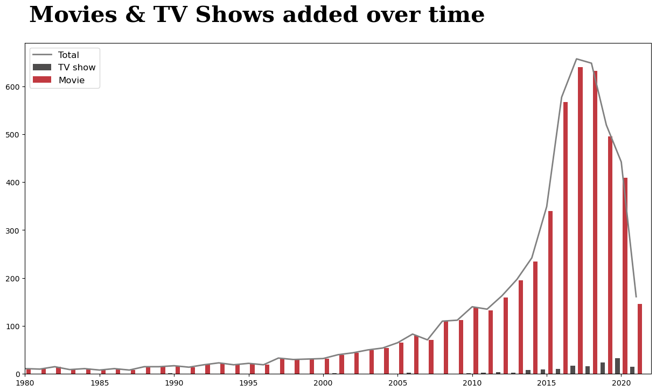
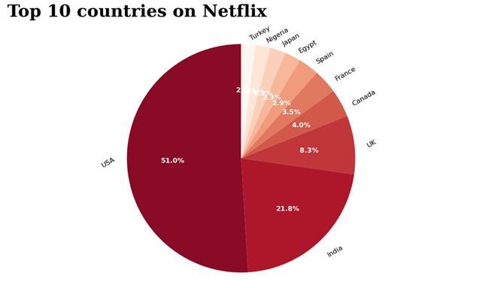

Netflix Dataset
4
DATA VISUALIZATION USING PYTHON

Slide 9
Netflix Dataset
Next
Studio – Home
TITLE - Netflix Movies & TV Shows Analysis using Tableau & Python
Professor - MICHAIL XYNTARAKIS
Made By – Ronil Surve & Shubham Sharma

Slide 10
thanks

